Slide 1

Influence of Social Networking apps/websites on our life
Shrutika Mokashi
Hemanth Varma
Janaki Sajja
Usability & Human Interaction
Capstone Project
EAI6030.
Notes:
Hi. This presentation is about a group project on “Usability testing” by the students of Northeastern University Shrutika, Hemanth & Janaki.

Slide 2
Contents
Executive Summary
Goals
Participant Selection
Method of Research
Data Analysis
Findings post analysis
Improvements and Recommendations
Business Rationale
Issues Uncovered
Video link
Conclusion
Notes:
The agenda of the presentation deals with these topics where we explain the step by step process and outcomes of the testing in detail.

Slide 3
Executive Summary
The research is about analyzing the influence of social networking apps/websites like Facebook, WhatsApp, Instagram on our lives.
As we all know these have become an inevitable part of our day to day lives and some of us, even check their phones even before getting out of their bed.
Four different kind of users have been chosen to share their experience for our research.
Their responses and recommendations have been collected.
Notes:
The analysis and research have been conducted on the “Influence of social networking apps/websites(Facebook, WhatsApp, Instagram) on our life”. To perform the research, we have chosen four different kinds of users. Their responses and recommendations have been collected.

Slide 4
Goals
Choose
Choose appropriate topic for a survey.
Come up
Come up with particular yet easy to understand survey so that users will be interested in finishing it from the start.
Design
Design the survey using selective survey tool.
Promote
Promote the survey to get people’s responses on it. Try to gather as much information as possible.
Take
Take feedback from the respondents and analyze the data gathered.
Propose
Propose the recommendations in order to improve the testing.
Notes:
As part of the research, the tasks involved are divided into the following goals which include:
1) Designing a survey using a survey tool and the survey questions should be easy to understand so that users will be interested in finishing the survey until the end.
2) Finding the right participants to get valuable responses and feedback. And get their approval for the kind of testing we have selected.
3) Explaining the participants about the expected feedback on different kinds of questions and analyze the user responses once they are done with the survey.
4) Understanding the loopholes and limitations from the user feedback and then reviewing them for new recommendations and methodologies to improve the results.

Slide 5
Participant Selection
The participant selection is mainly based on these factors:
What is their age.
How often do they go online.
What do they use social networking sites for.
Their confidence level in providing the feedback.
Their priority for.
Does the websites have what they are looking for or not?
People who are ready to explain their experience and who can allow us to record their experiences.
People who look for good UI and explore the features available.
Notes:
Participant selection plays a vital role in getting better survey results and feedback. Always select participants who are relevant to the product/service on which we are conducting the survey. The participant selection is done by considering the parameters like age, how often do they go online, what do they use social networking sites for, does the website have what they are looking for not, people who are ready to explain their experiences and who can allow us to record their experiences.

Slide 6

Method of research
We have chosen the survey method for research.
We wrote a questionnaire, with 21 questions in it.
The participants were first given the links of the survey which ask the same questions to large numbers of participants.
Hence, we were able to gather data of 30+ participants and understand their responses for influence of social networking apps/websites in the user point of view.
Notes:
To perform testing, we have selected survey as a method of research. The survey has 21 questionnaires. We have selected participants from various job roles like IT jobholders, housewives, chefs, students. Before sharing our survey link with the participants, all the rules, terms, conditions, and guidelines are explained clearly. Our survey was taken by more than 30 participants.

Slide 7
Data Analysis
The data collected from users include the survey report from the SoGoSurvey website.
Also feedback is taken from the participants, once they are done with their survey.
From this their answer to every question, were analyzed to understand the importance of social media in our life.
This data helps us to understand that which social media is used most, how many times users use social media and their point of view on various other questions.
To analyze the data we used python language and ploted various graphs.
Notes:
The report of user responses will be collected from the SoGoSurvey website in the form of a dataset. The user responses for each question will be analyzed to understand the user perspective on the impact of social media on human lives. This analysis helps in understanding which social media apps will be used the most, how often the users use social media in a day, and the user’s point of view on various other questions. We have used python programming to conduct data analysis and visualize the reports in the form of graphs and charts. This kind of analysis of feedback helps in understanding the user’s perspective on the impact of social networking apps/websites in their lives.

Slide 8
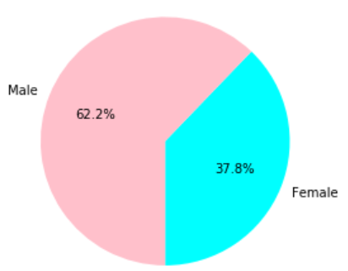
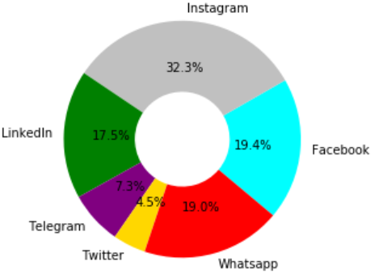
Findings post analysis:
Fig a
Fig b
Pie chart showing male and female
Participated in the survey.
Pie chart showing which app/website is used the most and the least.
Notes:
2.2% of the survey participants are males and 37.8% of the participants are females.
The most used social networking app is Instagram (32%) and Twitter (4.5%) is the least used app.
The pie chart shows that Instagram, Facebook, Whatsapp, and LinkedIn are widely being used.

Slide 9
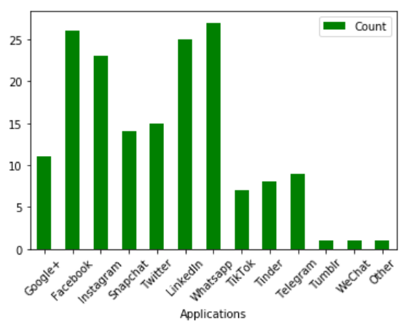
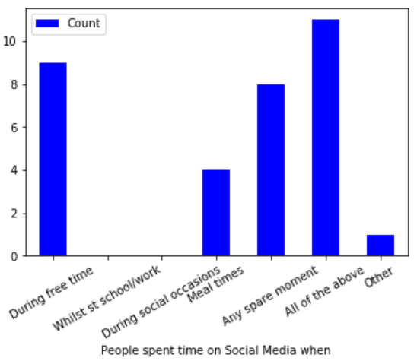
Findings post analysis:
Continued..
Fig c
Fig d
Bar graph showing number of users per app/website.
Bar graph showing when do they prefer to use the app/website.
Notes:
WhatsApp has the highest no. of users, followed by Facebook. Tumblr and WeChat have the least no. of users.
The usage rate of social media apps is high during spare time and free time. The usage is less while the users are at school, work, or social occasions.
Hence, people are spending their free and spare time browsing social networking apps to get rid of boredom or make themselves busy.

Slide 10
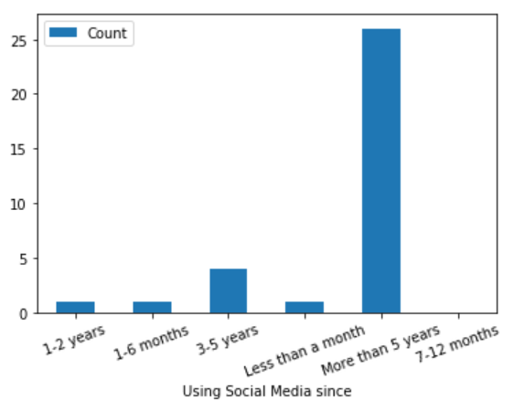
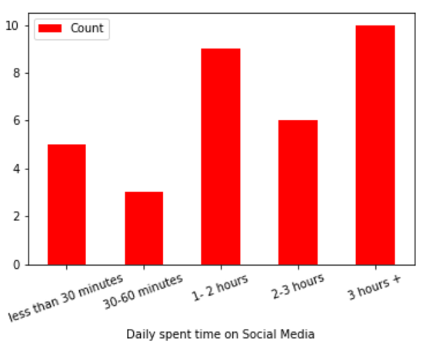
Findings post analysis:
Continued..
Fig e
Fig f
Bar graph showing since when users are using the social media.
Bar graph showing daily time spent on the social media.
Notes:
Most of the participants are using social media for more than 5 years now, which states its importance in our lives.
Most of the users are using social networking for more than 3 hours and very few users are active on social networking for 30-60 minutes. This shows that most of the participants are addicted to social networking apps.

Slide 11
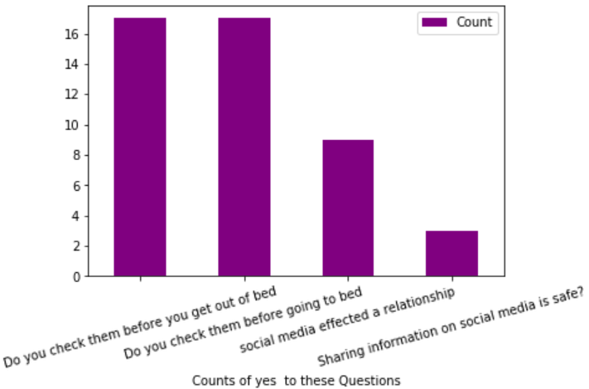
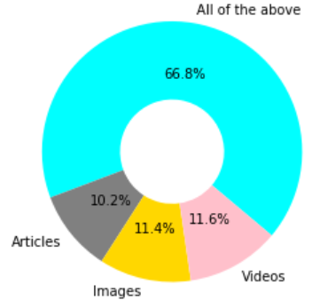
Findings post analysis:
Continued..
Fig g
Fig h
Bar graph showing when do users like using the social media.
Pie chart type of content users like in the social media.
Notes:
The least number of users (less than 4) found sharing information on social media is safe.
A high percentage of users are checking social networking apps before getting out of bed and before going to bed.
Social Networking apps/websites include contents of various types like articles, images, and videos.
66.8% of users like to browse articles, images, and video content on social networking.

Slide 12
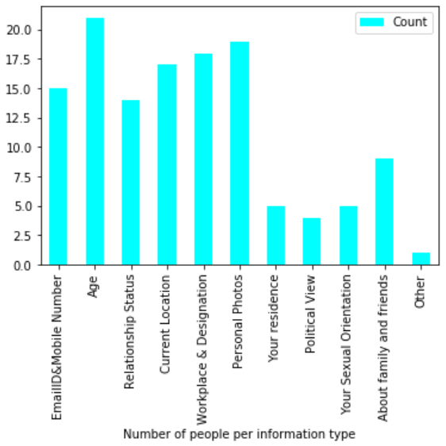
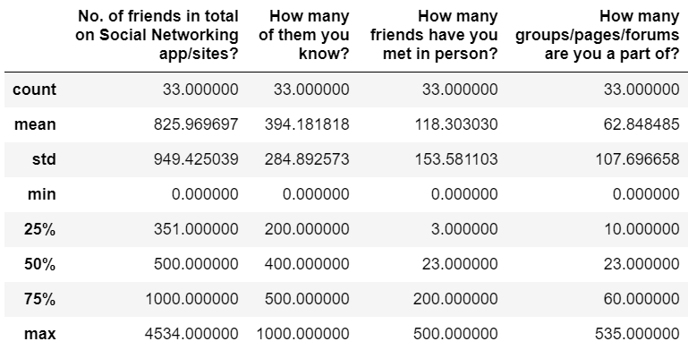
Findings post analysis:
Continued..
Fig i
Fig j
Bar graph showing the type of content users share on social media.
Table showing friends related details on social media.
Notes:
Most of the users like sharing their age, EmailID, and Mobile Number, Relationship Status, Current location, Workplace and Designation, Personal Photos on social networking apps.
Most of the users are not interested in sharing their political views, sexual orientation, and residential status on social networking apps.
The analysis shows that social networking apps are used by people mostly to share personal information and build friendships and connections.
Each person may have multiple friends on social media, but not every one of them is their friend and have not met everyone is a person.
People are interested in the following pages, forums, and groups as well as social media apps.

Slide 13
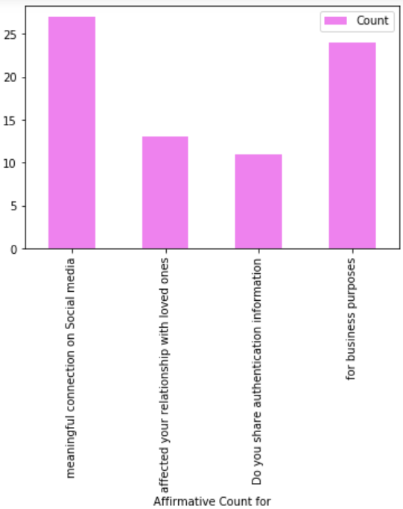
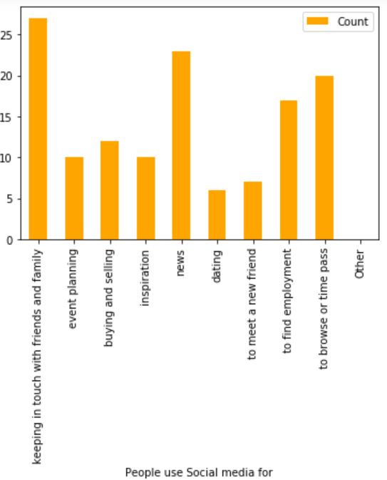
Findings post analysis:
Continued..
Fig l
Fig k
Bar graph showing the content type people use social media for.
Affirmative counts for given Questions
Notes:
196.97% of participants believe that social media helps in building meaningful connections. 80% of them believe that social networking is for business purposes.
30% of participants believe that relationships will get affected because of social networking and 30% of them wish to share authenticated information on social media.
Social media apps are also used to keep in touch with friends and family, for planning events, buying and selling products, and to find employment.
The analysis shows that social networks have become part of and connected directly or indirectly to every activity of our daily life.

Slide 14
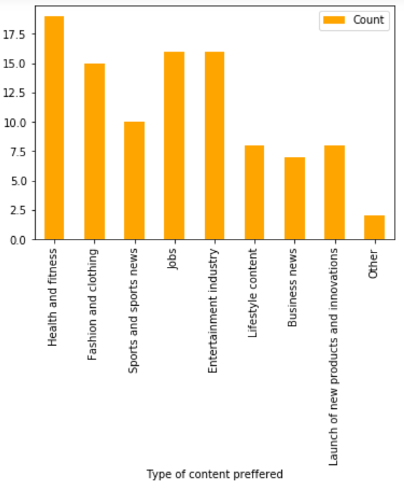
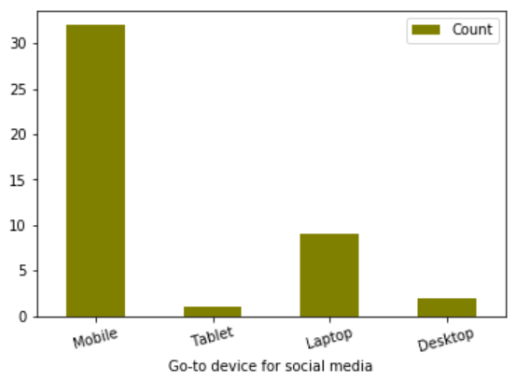
Findings post analysis:
Continued..
Fig m
Fig n
Bar graph go-to device to browse social media.
Table showing type of content preferred on social media.
Notes:
Most of the users wish to use social networking sites on Mobile and will rarely use tablets, laptops, and desktop to use social networking sites.
58% of people are interested in browsing health and fitness content on the social media, 50% are interested in fashion and clothing, 33% are interested in sports, 50% are interested in jobs, the entertainment industry and approximately 30% are interested in lifestyle, business and product innovation news.

Slide 15
Improvements/Recommendations:
The survey had more than 20 questions which made it lengthy and little time consuming.
1
We were able to record a good amount of information but we could not show all the analysis.
2
Apart from the radio grid, we could have used Likert but it was not available for free.
3
Also, this is very low cost and we can get real feedback from people who never did this earlier. So taking responses from anyone in this pandemic was literally possible.
4
Notes:
The survey had more than 20 questions which made it lengthy and little time-consuming. Though the survey method has given interesting responses, there is always much to have better results. The card sorting method helps in understanding the user’s logic and in making appropriate and informative decisions. Apart from the radio grid, we could have used Likert, but it was not available for free. Also, to have some real and impromptu responses, guerilla testing methodology would help.

Slide 16
Business Rationale:
These updates are important for testing for the following reasons:
Feedback from just 32 participants may not be enough
Real and impromptu responses can reveal more interesting facts.
Using tableau for analysis would have been easier.
Understanding user’s logic can help in making data informed decisions.
Notes:
Feedback from just 32 participants would not be enough for accurate feedback. Using Tableau for analysis would have been easier. The card sorting method helps in understanding the user’s logic and in making appropriate and informed decisions.

Slide 17
Issues Identified
Addiction to Social Media:
From total 66.7% participants, total 20 considered themselves as addicted to social media.
Privacy of our information shared on social media:
When it comes to Social media, we share lot of things from our current location to our current job designation. And 90.9% participants are concerned about their privacy.
Increase in usage of Social Networking apps/sites: Initially we were using social media for various reasons but now due to pandemic its usage has been increased. Because 90.9% participants has agreed to this.
Notes:
Addiction to social media.
Of the total 66.7% participants, a total of 20 considered themselves as addicted to social media.
Privacy of information shared on social networking sites.
When it comes to Social media, we share a lot of things from our current location to our current job designation. And 90.9% of participants are concerned about their privacy
Increase in usage of social networking apps/sites.
Initially, we were using social media for various reasons but now due to pandemic, its usage has been increased. Because 90.9% of participants have agreed to this.

Slide 18
Issues Uncovered
Celebrity influence on social media (severity 1):
Certain celebrities attract specific demographics and target audiences, companies that wish to reach those consumers can hire the celebrity influencer to promote or endorse their product to their fans.
Influence of Meme Creators on social media (severity 2):
When it comes to Social media, we know the importance of memes and their followers. It's impossible to ignore them as memes incept our minds easily, and unknowingly.
Influence of content Creators like bloggers, bloggers, and reviewers (severity 3):
Their role includes developing new content that readers are interested in keeping up with regularly. Part of a company’s marketing strategy could be to send products to a content creator in the hopes they will review and speak positively about it to their followers.
Notes:
The 3 issues that are uncovered in the testing are:
Issue1: Severity1: Celebrity influence on social media: Certain celebrities attract specific demographics and target audiences, companies that wish to reach those consumers can hire the celebrity influencer to promote or endorse their product to their fans.
Issue2: Severity2: Influence of Meme Creators on social media: When it comes to Social media, we know the importance of memes and their followers. It's impossible to ignore them as memes incept our minds easily, and unknowingly.
Issue3: Severity3: Influence of content Creators like bloggers, bloggers, and reviewers: Their role includes developing new content that readers are interested in keeping up with regularly. Part of a company’s marketing strategy could be to send products to a content creator in the hopes they will review and speak positively about it to their followers.

Slide 19

Video and Survey Link
User Responses: https://drive.google.com/file/d/1C6ZaMennrDjVa_nlsV0ROMpQZwau27vC/view?usp=sharing
Survey link: https://survey.sogosurvey.com/r/KZUzw4
Video Presentation Link: https://drive.google.com/file/d/1ndta1t45RVTWjTHb6lzLqcgeLW6bBi7m/view?usp=sharing
Notes:
The links to the survey, user responses, and video presentations are provided in this slide.

Slide 20

Conclusion
The research has revealed interesting facts and patterns from the participants.
But there is always a better way than what we have to encourage maximum number of participants and get better results.
Instagram is most preferred social networking app by participants. But still WhatsApp is most used app by participants. And 96.97% users think they were able to make meaningful connection on the Social
And most of the participants being using social media for more than 5 years now. Which states its importance in our lives.
Given the current data, we can say that Social Networking sites/apps are inevitable part of our lives and we have gotten addicted to it. This pandemic made us use them even more due to quarantine and social distancing.
More facts can be identified by increasing the number of users.
Notes:
Many interesting facts and patterns have been observed based on the user responses and their feedbacks. However, results would have been better if the number of participants is more. Instagram, WhatsApp, and Facebook are being used by most of the users. Social networking apps are highly useful to build connections and networks. From the overall analysis, we can say that social networking apps/sites are significant in our lives, and because of this pandemic and social distancing, the usage of social networking apps/sites has widely increased.

Slide 21

Notes:
Thank you so much for listening to us. Hope you liked our presentations. Stay safe!

